Slide 1
Exam 1 Review

Slide 2
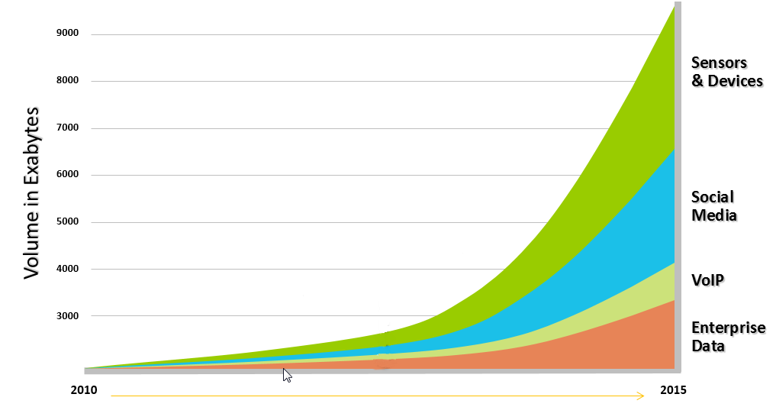
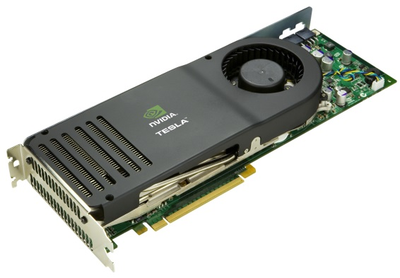
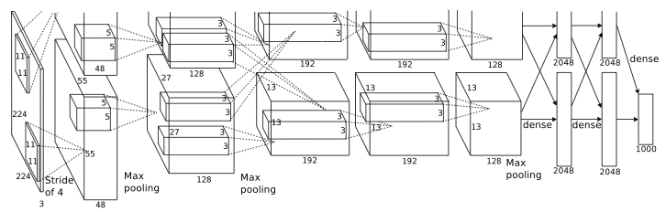
Why has machine learning become very relevant recently?
More data is being generated than ever before (Data flood):
Digitalization of information
Banking
Telecom
Media
...
Sensor networks
Scientific data: astronomy, biology, sociology
Web
Advances in hardware provide increased computational capability
GPUs
Theoretical breakthroughs
Deep learning
Notes:
Not only the amount of data being collected is getting larger, the complexity of this data is also increasing by leaps and bounds!

Slide 3
Linear algebra

Slide 4
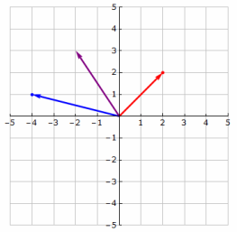
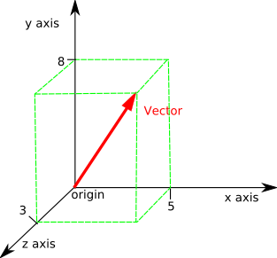
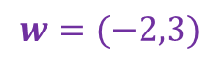
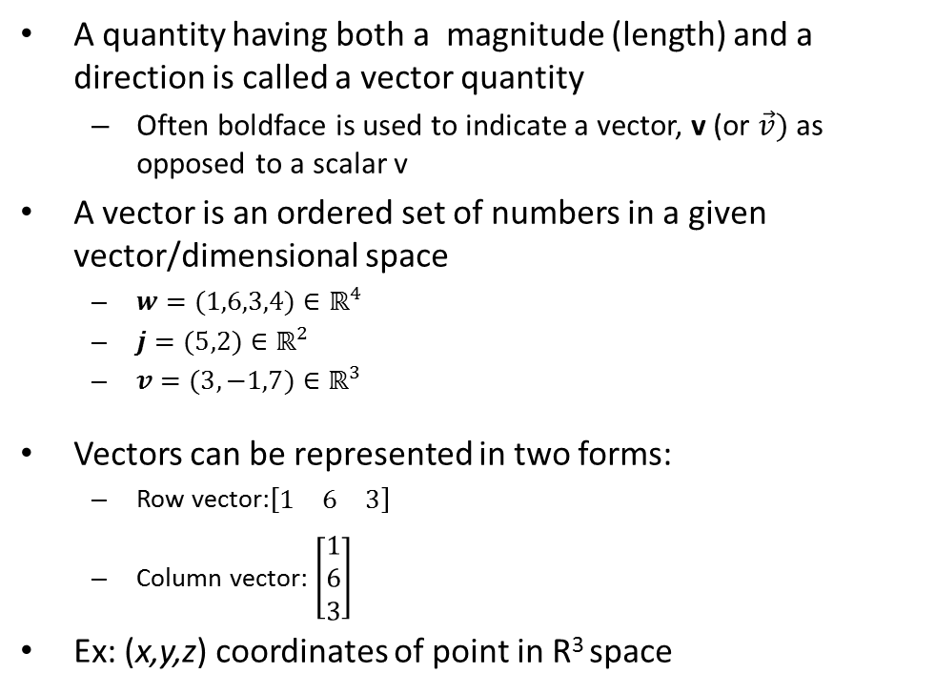
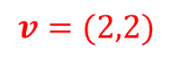
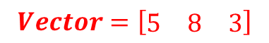
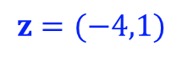
Vectors
A quantity having both a magnitude (length) and a direction is called a vector quantity
Often boldface is used to indicate a vector, v (or $\vec{v})$as opposed to a scalar v
A vector is an ordered set of numbers in a given vector/dimensional space
$w=(1,6,3,4)∈ℝ^{4}$
$j=(5,2)∈ℝ^{2}$
$v=(3,−1,7)∈ℝ^{3}$
Vectors can be represented in two forms:
Row vector:$\left[\begin{matrix}1 & 6 & 3\end{matrix}\right]$
Column vector: $\left[\begin{matrix}1 \\ 6 \\ 3\end{matrix}\right]$
Ex: (x,y,z) coordinates of point in R³ space
$$v=(2,2)$$
$$z=(−4,1)$$
$$w=(−2,3)$$
$$Vector=\left[\begin{matrix}5 & 8 & 3\end{matrix}\right]$$

Slide 5
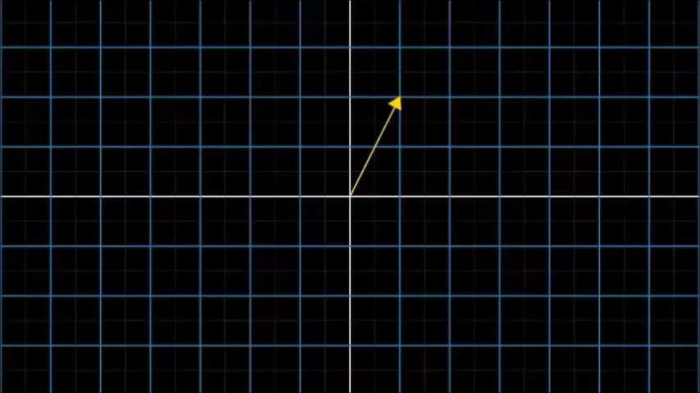
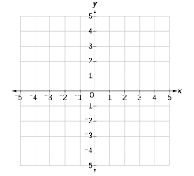
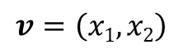




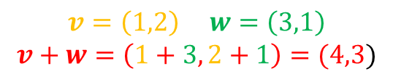
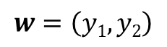
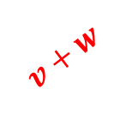
Vector Addition
$$v=\left(x1,x2\right)$$
$$w=\left(y1,y2\right)$$
$$v$$
$$w$$
$$v$$
$$w$$
$$v+w$$
$$v=\left(1,2\right) w=\left(3,1\right)$$
$$v+w=\left(1+3, 2+1\right)=(4,3)$$

Slide 6

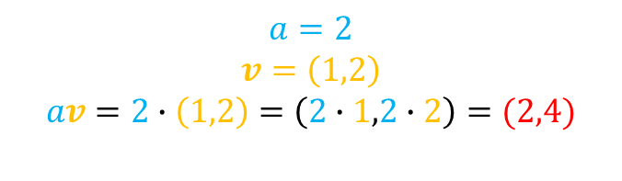


Scalar Product
(stretching or shrinking a vector)
The scalar product of a vector stretches or shrinks or inverts the length (“scaling”) of the vector, but keeps its direction fixed.
av
v
$$av$$
$$v$$
$$a=2$$
$$v=\left(1,2\right)$$
$$av=2∙\left(1,2\right)=\left(2∙1,2∙2\right)=(2,4)$$

Slide 7
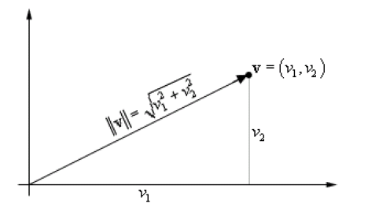
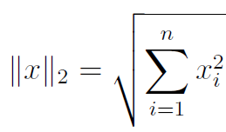
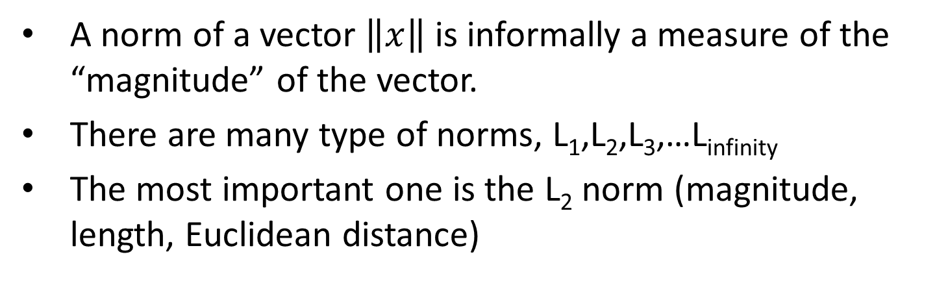
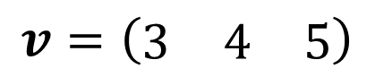
Vector norms
A norm of a vector $\left\|x\right\|$ is informally a measure of the “magnitude” of the vector.
There are many type of norms, L₁,L₂,L₃,…L_{infinity}
The most important one is the L₂ norm (magnitude, length, Euclidean distance)
$$v=\left(\begin{matrix}3 & 4 & 5\end{matrix}\right)$$
$$L2\left(v\right)=\left\|v\right\|2=\left|v\right|=\sqrt[2]{3^{2}+4^{2}+5^{2}}=\sqrt[2]{50}≈7.07$$

Slide 8
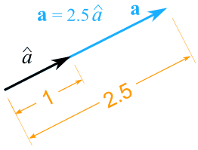
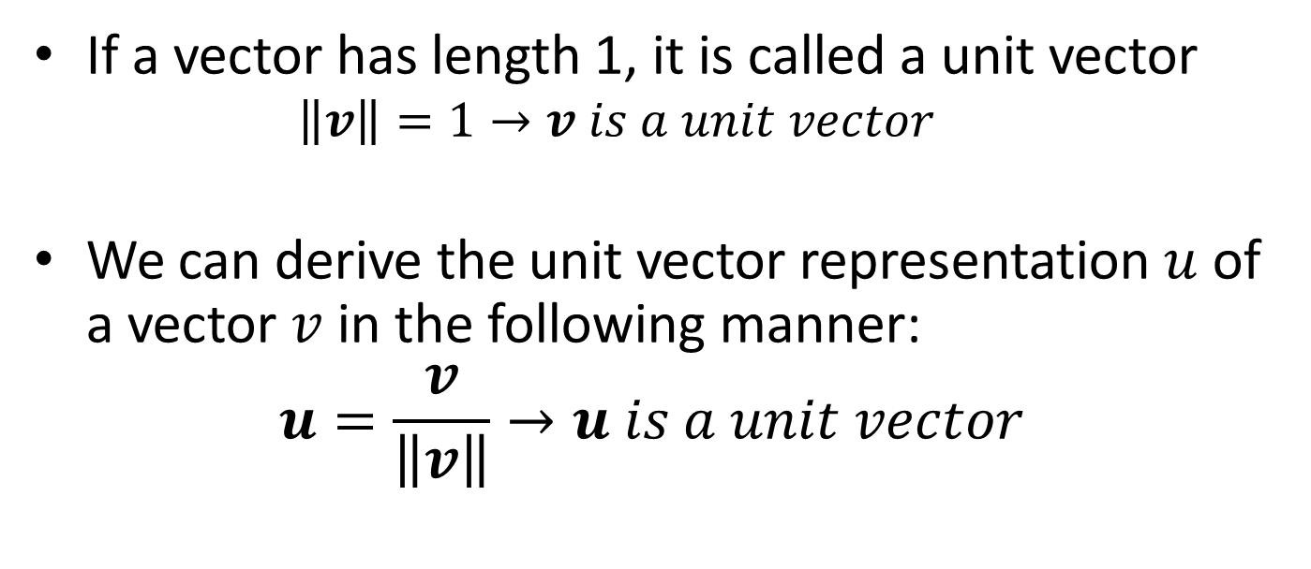
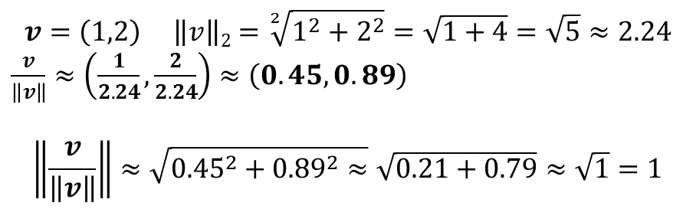
Unit vector
If a vector has length 1, it is called a unit vector
$$\left\|v\right\|=1→v is a unit vector$$
We can derive the unit vector representation $u$ of a vector $v$in the following manner:
$$u=\frac{v}{\left\|v\right\|}→u is a unit vector$$
$$v=\left(1,2\right) \left\|v\right\|2=\sqrt[2]{1^{2}+2^{2}}=\sqrt{1+4}=\sqrt{5}≈2.24$$
$\frac{v}{\left\|v\right\|}≈\left(\frac{1}{2.24},\frac{2}{2.24}\right)≈\left(0.45,0.89\right)$
$$\left\|\frac{v}{\left\|v\right\|}\right\|≈\sqrt{{0.45}^{2}+{0.89}^{2}≈}\sqrt{0.21+0.79}≈\sqrt{1}=1$$

Slide 9
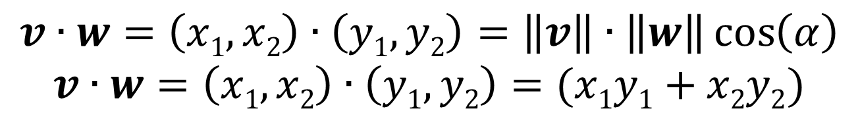
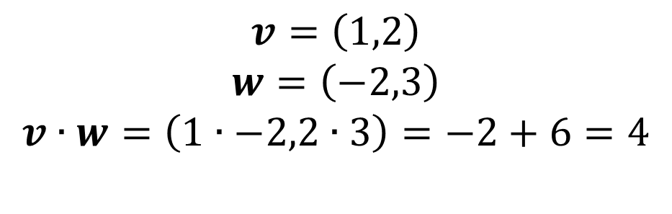
Dot Product aka inner product
v
The inner product of 2 vectors results in a SCALAR!
α
w
$$v∙w=\left(x1,x2\right)∙\left(y1,y2\right)=\left\|v\right\|∙\left\|w\right\|\cos\left(α\right)$$
$$v∙w=\left(x1,x2\right)∙\left(y1,y2\right)=(x1y1+x2y2)$$
$$v=\left(1,2\right)$$
$$w=\left(−2,3\right)$$
$$v∙w=\left(1∙−2,2∙3\right)=−2+6=4$$
Please note that this is probably the most important mathematical operation in machine learning!

Slide 10
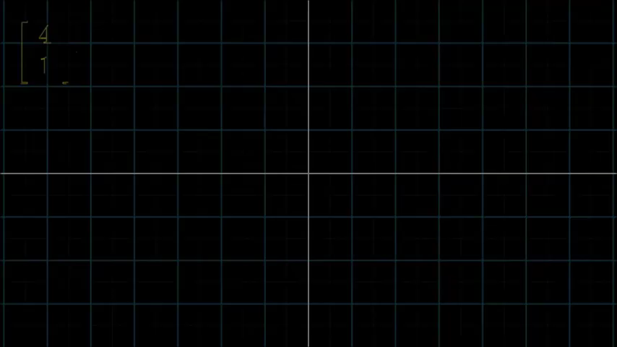
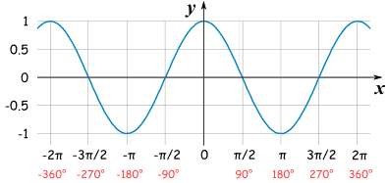
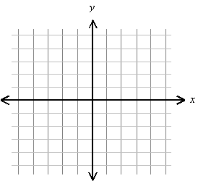
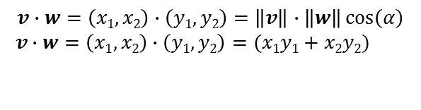
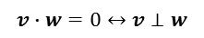
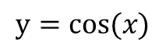
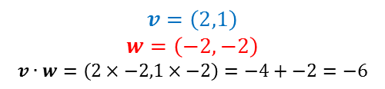
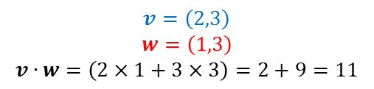
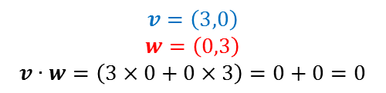
The dot product can be thought of as a tool to determine the similarity between 2 vectors
$$y=cos⁡(x)$$
$$v∙w=\left(x1,x2\right)∙\left(y1,y2\right)=\left\|v\right\|∙\left\|w\right\|\cos\left(α\right)$$
$$v∙w=\left(x1,x2\right)∙\left(y1,y2\right)=(x1y1+x2y2)$$
$$v=\left(3,0\right)$$
$$w=\left(0,3\right)$$
$$v∙w=\left(3×0+0×3\right)=0+0=0$$
$$v=\left(2,3\right)$$
$$w=\left(1,3\right)$$
$$v∙w=\left(2×1+3×3\right)=2+9=11$$
$$v=\left(2,1\right)$$
$$w=\left(−2,−2\right)$$
$$v∙w=\left(2×−2,1×−2\right)=−4+−2=−6$$
$$v∙w=0↔v⊥w$$
Notes:
If 2 vectors are orthogonal, their dot product will be 0

Slide 11
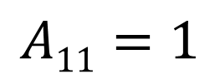
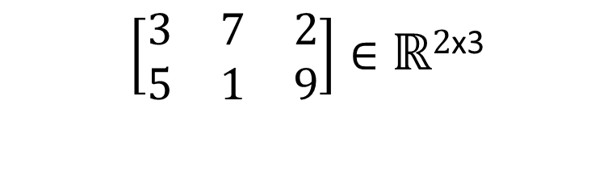
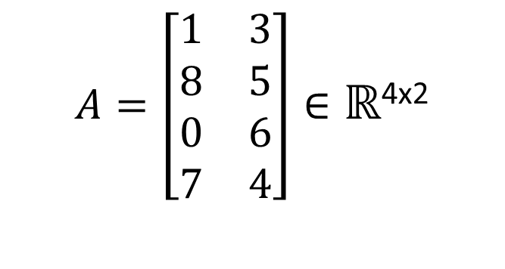
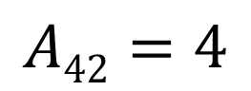
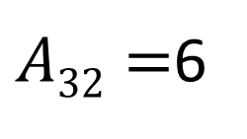
What is a Matrix?
A matrix is a set of elements, organized into rows and columns (a 2D array for programmers)
A rectangular array of numbers
You can think of it as a sequence of row or column vectors
Dimension of matrix: number of rows x number of columns
rows
$$\left[\begin{matrix}3 & 7 & 2 \\ 5 & 1 & 9\end{matrix}\right]∈ℝ2\text{x}\text{3}$$
$$A11=1$$
$$A=\left[\begin{matrix}1 & 3 \\ 8 & 5 \\ 0 & 6 \\ 7 & 4\end{matrix}\right]∈ℝ\text{4}\text{x}\text{2}$$
columns
$A32=$6
$$A42=4$$
Notes:
A matrix is usually identify with a capital letter in bold
Vector is just a n x 1 matrix

Slide 12
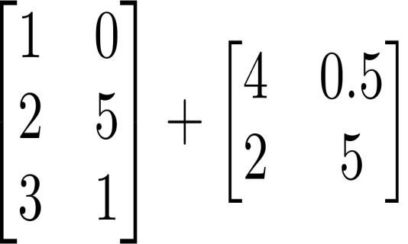
Basic Matrix Operations
Addition, Subtraction
Matrices need to have the same dimensions in order to carry out matrix addition/subtraction!
Just add elements
Just subtract elements
Cannot be done since matrices dimensions are not equal

Slide 13
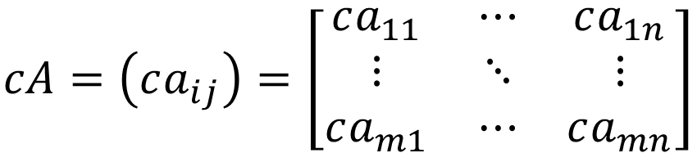

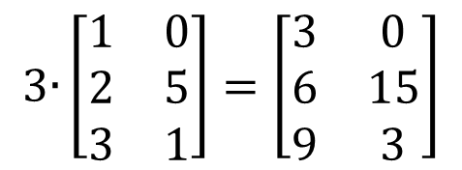
Scalar Multiplication
Let A = (a_{ij}) denote an n × m matrix and let c be any scalar. Then cA is the matrix
$$cA=\left(ca_{ij}\right)=\left[\begin{matrix}ca_{11} & ⋯ & ca_{1n} \\ ⋮ & ⋱ & ⋮ \\ ca_{m1} & ⋯ & ca_{mn}\end{matrix}\right]$$
$$3\text{∙}\left[\begin{matrix}1 & 0 \\ 2 & 5 \\ 3 & 1\end{matrix}\right]=\left[\begin{matrix}3 & 0 \\ 6 & 15 \\ 9 & 3\end{matrix}\right]$$
$$\left[\begin{matrix}4 & 0 \\ 6 & 3\end{matrix}\right]∙\frac{1}{4}=\frac{\left[\begin{matrix}4 & 0 \\ 6 & 3\end{matrix}\right]}{4}=\left[\begin{matrix}1 & 0 \\ 1.5 & 0.75\end{matrix}\right]$$

Slide 14

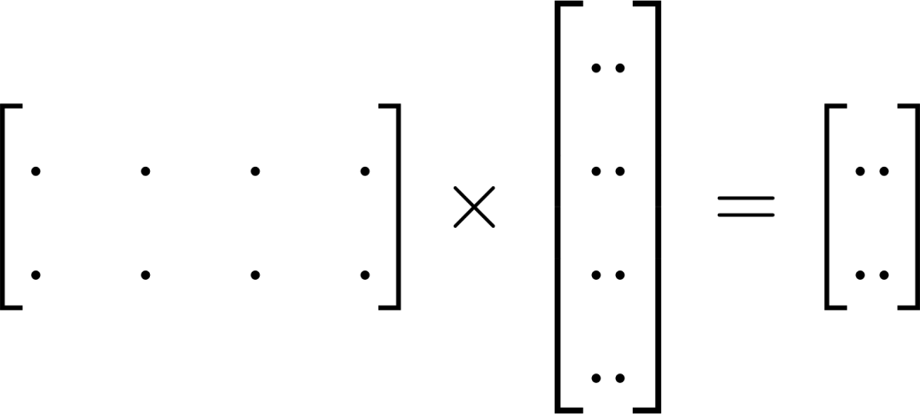
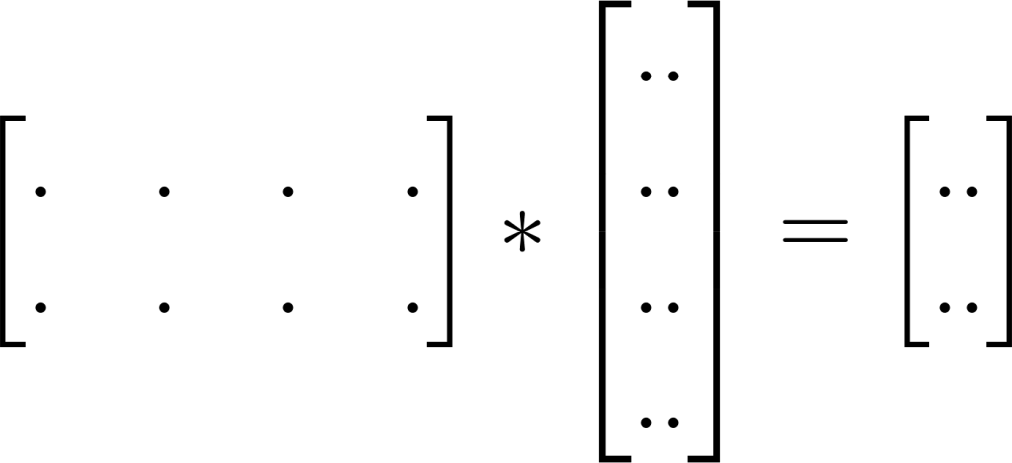


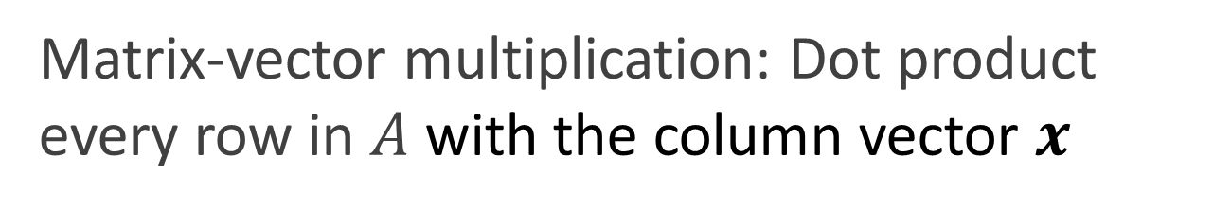
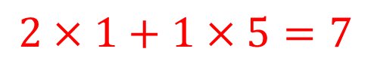
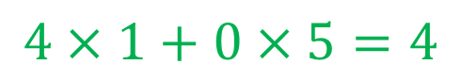
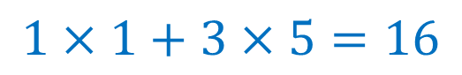
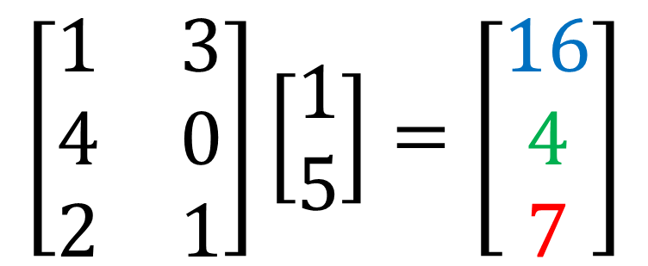
Matrix-vector multiplication: Dot product every row in $A$ with the column vector $x$
$$\left[\begin{matrix}1 & 3 \\ 4 & 0 \\ 2 & 1\end{matrix}\right]\left[\begin{matrix}1 \\ 5\end{matrix}\right]=\left[\begin{matrix}16 \\ 4 \\ 7\end{matrix}\right]$$
$$1×1+3×5=16$$
$$4×1+0×5=4$$
$$2×1+1×5=7$$
Notice: The number of columns in matrix A must coincide with the number of rows in vector x in order to carry out the product

Slide 15

Matrix multiplication
When A is a mxn matrix & B is a kxl matrix, AB is only possible if n=k (columns in A = rows in B)
Critical insight:
Dot product each row in 1st matrix by each column in 2nd matrix
Notes:
15

Slide 16








Examples
$$\left[\begin{matrix}1 & 3 \\ 2 & 5\end{matrix}\right]\left[\begin{matrix}0 & 1 \\ 3 & 2\end{matrix}\right]=\left[\begin{matrix}9 & 7 \\ 15 & 12\end{matrix}\right]$$
$ℝ2$^{x2}
$ℝ2$^{x2}
$ℝ2$^{x2}
$$\left[\begin{matrix}1 & 3 & 2 \\ 4 & 0 & 1\end{matrix}\right]\left[\begin{matrix}1 & 3 \\ 0 & 1 \\ 5 & 2\end{matrix}\right]=\left[\begin{matrix}11 & 10 \\ 9 & 14\end{matrix}\right]$$
$ℝ2$^{x3}
$ℝ3$^{x2}
$ℝ2$^{x2}

Slide 17


The transpose of a matrix
Consider the n × m matrix, A
A^{T} (sometimes indicated with A’) is called the transpose of A when A_{ij}=A^{t}_{ji}
Basically, to transpose A into A^{T} transform every row of A into a column of A^{T}

Slide 18



Identity Matrix
A special matrix which plays a similar role as the number 1 in scalar (single number) multiplication
An n × n identity matrix, I, is the square matrix
Note:
$$I_{3}=\left[\begin{matrix}1 & 0 & 0 \\ 0 & 1 & 0 \\ 0 & 0 & 1\end{matrix}\right]$$
AI = A
IA = A.
$$I_{2}=\left[\begin{matrix}1 & 0 \\ 0 & 1\end{matrix}\right]$$
Worked example
A I₃ = A
for a 3x3 matrix:
1 | 2 | 3 |  | 1 | 0 | 0 |  | 1+0+0 | 0+2+0 | 0+0+3
4 | 5 | 6 | X | 0 | 1 | 0 | = | 4+0+0 | 0+5+0 | 0+0+6
7 | 8 | 9 |  | 0 | 0 | 1 |  | 7+0+0 | 0+8+0 | 0+0+9
$$=\left[\begin{aligned}\begin{aligned}\begin{matrix}\begin{matrix}1 & 2 & 3 \\ 4 & 5 & 6 \\ 7 & 8 & 9\end{matrix} \end{matrix}\end{aligned}\end{aligned}\right]=A$$

Slide 19

The inverse of an n × n matrix
Let A denote the n × n matrix
A must be square (number of rows equal number of columns) for A⁻¹ to exist
$$A=\left(a_{ij}\right)=\left[\begin{matrix}a_{11} & ⋯ & a_{1n} \\ ⋮ & ⋱ & ⋮ \\ a_{m1} & ⋯ & a_{mn}\end{matrix}\right]$$
Let B denote an n × n matrix such that
AB = BA = I,
If the matrix B exists then A is called invertible Also B is called the inverse of A and is denoted by A⁻¹

Slide 20








Not all numbers have an inverse. The number 0 does not have an inverse
$$x^{−1}=\frac{1}{x}$$
$$3∙3^{−1}=3∙\frac{1}{3}=\frac{3}{3}=1$$
$$0∙0^{−1}=0∙\frac{1}{0}=Undefined$$
$$3^{−1}=\frac{1}{3}$$
Matrix inverse:
If A is an m x m square matrix, and if it has an A⁻¹ inverse,
1 | 1 | X | 2 3 | -1 3 | = | 2 + 1 3 3 | -1 + 1 3 3 | = | 1 | 0
-1 | 2 |  | 1 3 | 1 3 |  | -2+ 2 3 3 | 1 + 2 3 3 |  | 0 | 1
$$A$$
$$A^{−1}$$
$${AA}^{−1}$$
$$I$$
Notes:
Not essential notes:
For a matrix to be invertible, its determinant has to be non-zero
A matrix that is not invertible is said to be singular

Slide 21







Why is all this relevant?
In machine learning, data is often represented as a matrix of rows and columns
Machine learning algorithms often try to find solutions of systems of equations that are often represented as matrices
Solving those systems of equations means finding the optimal weights(w)/parameters ($θ$) to minimize a cost function (i.e. Fit the model to the data)
$$X$$
$$y$$
$$X$$
$$θ$$
$$y$$
$$\left(\begin{matrix}1 & 1 & 2 \\ 3 & −2 & 4 \\ 1 & −1 & −1\end{matrix}\right)\left(\begin{matrix}θ1 \\ θ2 \\ θ3\end{matrix}\right)=\left(\begin{matrix}0 \\ 9 \\ 0\end{matrix}\right)$$
$$Xθ=y$$
$$θ=X^{−1}y$$

Slide 22

Where are we at?

Slide 23



Linear equation
$$y=x+2$$
$$y=mx+b$$
slope
intercept

Slide 24


Using the linear equation to model data
Question: can we find a linear equation that allow us to determine the value of the Tire Wear (Groove Depth) from the value of the independent variable (Mileage)?
$$y=θ0+θ1x$$

Slide 25
Which line has the best fit to the data?
Minimize the distance between the points and the hypothesis line
The method of least squares produces a straight line that minimizes the sum of the squared differences between the points and the line
y
y
y
x
x
x

Slide 26
Which line has the best fit to the data?
Plots of the data points (crosses in red), and several model lines (in blue), with the residuals shown in green
y
y
y
x
x
x

Slide 27







Mathematical formalization of how to choose the optimal parameters to get a least squares line Least Squares fitting
$$X$$
$$y$$
$$hθ(x)=θ0+θ1x$$
y
Minimize cost function J for $θ0,θ1$
$$J\left(θ0,θ1\right)=\frac{1}{2m}\sum_{i=1}^{m}{(hθ\left(xi)−y_{i}\right)2 }$$
x
Intuition: choose $θ_{0},θ_{1}$so that $h_{θ}\left(x\right)$ is close to our training examples $(x,y)$
Notation:
x’s = “input” variable / features
y’s = “output” variable / “target” variable
$h_{θ}$ = the model
$h_{θ}(x_{i})$= the $y_{i}$prediction of the model for input $x_{i}$

Slide 28











$$θ1=2$$
$$θ1=1.5$$
$J\left(θ_{1}\right)$ = cost function of parameter $θ_{1}$
$$θ1=1$$
y
$$θ1=0.5$$
$$θ1=0$$
x
$$θ1=1 minimizes J\left(θ1\right)$$
Optimal model: $θ_{1}=1 → hθ\left(x\right)=x$

Slide 29



Intuition about finding the minimum of a multivariable function
Imagine you’re blindfolded, but you can feel your immediate terrain surroundings by using your feet. I drop you off somewhere and tell you that you’re in a convex shaped valley and escape is at the bottom/minimum. How would you reach the bottom of the Valley?

Slide 30









Bivariate linear regression – predicting the price of a house using two features (two independent variable)
$$X$$
$$y$$
Size (feet²) | Age of home (years) | Price ($1000)
2104 | 45 | 460
1416 | 40 | 232
1534 | 30 | 315
852 | 36 | 178
… | … | …
$$x1$$
$x$₂
$$y$$
$$y$$
$$y=hθ\left(x\right)=θ0+θ1x1+θ2x2$$
$x$₂
$$x1$$

Slide 31









Multivariate linear regression – predicting the price of a house using several features (in this example, 4 independent variables)
$$X$$
$$y$$
Size (feet²) | Number of bedrooms | Number of floors | Age of home (years) | Price ($1000)
2104 | 5 | 1 | 45 | 460
1416 | 3 | 2 | 40 | 232
1534 | 3 | 2 | 30 | 315
852 | 2 | 1 | 36 | 178
… | … | … | … | …
$$x1$$
$x$₂
$$x3$$
$x$₄
$$y$$
$$y=hθ\left(x\right)=θ0+θ1x1+θ2x2+θ3x3+θ4x4$$
Notation:
$x^{(i)}$= input (features) of $i^{th}$ training
${xj}^{(i)}$= value of feature $j$ in $i^{th}$ training example
${ x}^{(3)}=$[1534,3,2,30]
${ x2}^{(3)}=$ 3 ${ y}^{(3)}=315$

Slide 32

What about non-linear relationships in the data ?
Linear relationships
Lack of linear relationships

Slide 33



There is a trick though for the linear regression technique to still properly fit nonlinear data:
Polynomial regression through nonlinear transformations
You can still use the linear regression technique to model nonlinear relationships between predictors $X$ and outputs $y$ using the trick of transforming the input features in $X$ using nonlinear transformations
Obviously, a linear model will not properly describe this curvilinear data
Price
(y)
$$y=θ0+θ1x$$
$$X=\left[\begin{matrix}3 \\ 1 \\ \begin{aligned}2 \\ 0\end{aligned}\end{matrix}\right]$$
Size (x)

Slide 34






The trick consists on adding additional artificial features to $X$ formed by nonlinear transformations of the original data features in $X$
Polynomial regression through nonlinear transformations
Nonlinear transformation $Φ$ of input features
$$φ(x)→{x,x}^{2}$$
$$y=θ0+θ_{1}x_{1}+θ2{x_{1}}^{2}$$
Price
(y)
$$X=\left[\begin{matrix}3 \\ 1 \\ \begin{aligned}2 \\ 0\end{aligned}\end{matrix}\right]$$
$$X^{′}=φ(X)=\left[\begin{matrix}3 & 9 \\ 1 & 1 \\ \begin{aligned}2 \\ 0\end{aligned} & \begin{aligned}4 \\ 0\end{aligned}\end{matrix}\right]$$
Size (x)

Slide 35






The more additional artificial features added to $X$ the more complex models we will be able to create
Polynomial regression through nonlinear transformations
Nonlinear transformation $Φ$ of input features
$$φ(x)→{x,x}^{2},x^{3}$$
Price
(y)
$$y=θ0+θ1x_{1}+θ2{x_{1}}^{2}+θ{x_{1}}^{3}$$
$$X=\left[\begin{matrix}3 \\ 1 \\ \begin{aligned}2 \\ 0\end{aligned}\end{matrix}\right]$$
$$X^{′}=φ(X)=\left[\begin{matrix}3 & 9 & 27 \\ 1 & 1 & 1 \\ \begin{aligned}2 \\ 0\end{aligned} & \begin{aligned}4 \\ 0\end{aligned} & \begin{aligned}8 \\ 0\end{aligned}\end{matrix}\right]$$
Size (x)

Slide 36





Polynomial regression through nonlinear transformations
Nonlinear transformation $Φ$ of input features
$$φ(x) →x,\sqrt{x}$$
$$y=θ0+θ1x_{1}+θ2\sqrt{x_{1}}$$
Price
(y)
$$X=\left[\begin{matrix}3 \\ 1 \\ \begin{aligned}2 \\ 0\end{aligned}\end{matrix}\right]$$
$$X^{′}=φ(X)=\left[\begin{matrix}3 & \sqrt{3} \\ 1 & \sqrt{1} \\ \begin{aligned}2 \\ 0\end{aligned} & \begin{aligned}\sqrt{2} \\ \sqrt{0}\end{aligned}\end{matrix}\right]$$
Size (x)
Important: You still apply a linear regression model to the nonlinearly transformed input features, but because you are doing that in a higher dimensional space, the resulting hyper plane will probably work well if your data is not too pathological

Slide 37

Feature scaling/normalization
Feature scaling is a method used to standardize the range of independent variables or features of data
It is also known as data normalization and is generally performed during the data preprocessing step.
Since the range of values of raw data varies widely, in some machine learning algorithms, objective functions will not work properly without normalization.
The majority of classifiers calculate the distance between two points using the Euclidean distance, if one of the features has a broad range of values, the distance will be governed by this particular feature
Therefore, the range of all features should be normalized so that each feature contributes approximately proportionately to the final distance
Size (feet²) | Number of bedrooms | Number of floors | Age of home (years) | Price ($1000)
2104 | 5 | 1 | 45 | 460
1416 | 3 | 2 | 40 | 232
1534 | 3 | 2 | 30 | 315
852 | 2 | 1 | 36 | 178
… | … | … | … | …

Slide 38






There are many techniques to do Feature scaling: rescaling, centering, standardization and normalization to unit length
Rescaling
To range in [-1,1] or [0, 1]
Centering
To mean 0
Normalization/Standardization
zero-mean (when subtracting the mean in the numerator) and unit-variance. Widely used for normalization in many machine learning algorithms
Normalization to unit length
the converted vector $\hat{z}$ has length one
$$\hat{z}=\frac{x−min⁡(x)}{\max\left(x\right)−min⁡(x)}$$
$$\hat{z}=\frac{x}{\max\left(x\right)}$$
$\hat{z}=$ $x−μ$
$$\hat{z}=\frac{x−μ}{σ}$$
$$\hat{z}=\frac{x}{\left\|x\right\|}$$

Slide 39





Features scaling: centering and normalization
$$zn=x_{n}−\overline{x}$$
$$zn=\frac{xn−\overline{x}}{σn}$$

Slide 40
Feature scaling/normalization/standardization Summary
Rescaling
To range in [0, 1]
Standardization
95% of the data in range [-2,2]
zero-mean (when subtracting the mean in the numerator) and unit-variance. Widely used for normalization in many machine learning algorithms
$$\hat{z}=\frac{x}{\max\left(x\right)}$$
$$\hat{z}=\frac{x−μ}{σ}$$
Salary | Rescaling | Standardization
2000 | $$\hat{z}=\frac{2000}{3000}=0.67$$ | $$\hat{z}=\frac{2000−1875}{740}=0.17$$
1500 | $$\hat{z}=\frac{1500}{3000}=0.5$$ | $$\hat{z}=\frac{1500−1875}{740}=−0.51$$
3000 | $$\hat{z}=\frac{3000}{3000}=1$$ | $$\hat{z}=\frac{3000−1875}{740}=1.52$$
1000 | $$\hat{z}=\frac{1000}{3000}=0.33$$ | $$\hat{z}=\frac{1000−1875}{740}=−1.18$$
$$mean→μ=1875$$
$$standard deviation→σ=740$$

Slide 41
Web scraping vs API
2 ways of capturing data from the Internet
Web Scraping/HTML Parsing
API
(application programming interface)
Use HTTP requests and parse returned HTTP responses (HTML, XML,etc) to scrape relevant information
The data source eases our access to the data through a well documented protocol
Makes the call for us (the author is “allowing us” to access the data and has created a logical interface to serve the data to us)

Slide 42
Where are we at?

Slide 43


Classification
Regression
In regression problems, you try to find the trend in the data
In classification problems you try to find the boundary that separates the data into its discrete classes

Slide 44




Hypotheses/model representation in Logistic regression
Sigmoid function aka
Logistic function
Logistic regression uses the sigmoid function model to separate the data:
$hθ\left(x\right)=p\left(x\right)=g\left(x\right)=\frac{1}{1+e^{−(θ0+θ1x)}}$
$e≈2.71828$is a mathematical constant [Eulers number]
$0≤p\left(x\right)≤1$
The sigmoid function squeezes an infinite input space [$−∞,∞$] into the range [0,1]
The parameters $θ0$ and $θ1$ in logistic regression do not represent any more Y intercept and slope in the same sense as in linear regression
$$\frac{1}{1+e^{−(θ0+θ1x)}}$$

Slide 45





Logistic regression sigmoid function parameters
Changing the $θ0$parameter shifts the function horizontally
$$hθ\left(x\right)=\frac{1}{1+e^{−(θ0+θ1x)}}$$
$$θ0$$
$$θ0$$
$$θ0$$

Slide 46





Logistic regression sigmoid function parameters
Changing the $θ1$parameter changes the slope of the curve
$$hθ\left(x\right)=\frac{1}{1+e^{−(θ0+θ1x)}}$$
$$θ1$$
$$θ0$$
$$θ1$$
$$θ0$$
$$θ1$$
$$θ0$$

Slide 47

Changing the parameters of the model can improve classification accuracy
1
0.5
Probability of credit card fraudulent transaction
0
Frequency of credit card transactions per hour
$$hθ\left(x\right)=\frac{1}{1+e^{−(θ0+θ1x)}}$$

Slide 48
Making predictions
Once gradient descent has estimated the optimal $θ0$ and $θ$₁ for our logistic regression model, the model can carry out predictions
What is the model estimated probability of default for someone with a negative credit card balance of $1000 or $2000 given a model with the following optimal parameters: $θ0=−10.65, θ1=0.0055$
$p\left(x\right)=\frac{1}{1+e^{{−(θ}_{0}+θ_{1}x)}}→ p\left(1000\right)=\frac{1}{1+e^{−(θ_{0}+θ_{1}∙1000)}}=0.006$
$p\left(x\right)=\frac{1}{1+e^{{−(θ}_{0}+θ_{1}x)}}→ p\left(2000\right)=\frac{1}{1+e^{{−(θ}_{0}+θ_{1}∙1000)}}=0.$586

Slide 49






In Logistic regression the decision Boundary represents the 50% probability of assignment to either class in a binary classification problem
Optimal Parameters of the model
Feature vector
x₂
3
$$y=1$$
$$θ=\left[\begin{matrix}−3 \\ 1 \\ 1\end{matrix}\right]$$
$$x=\left[\begin{matrix}1 \\ x1 \\ x2\end{matrix}\right]$$
2
1
Decision boundary
$$y=0$$
1
2
3
x₁
$$hθ\left(x1,x2\right)=hθ\left(2,1\right)=g\left(θTx\right)=\frac{1}{1+e^{{−(θ}_{0}+θ_{1}x1+θ_{2}x2)}}=\frac{1}{1+e^{−(−3+2+1)}}=\frac{1}{1+e^{−(0)}}$$
$$hθ\left(x1,x2\right)=hθ\left(3,2\right)=g\left(θTx\right)=\frac{1}{1+e^{{−(θ}_{0}+θ_{1}x1+θ_{2}x2)}}=\frac{1}{1+e^{−(−3+3+2)}}=\frac{1}{1+e^{−(2)}}$$
$$hθ\left(x1,x2\right)=hθ\left(1,1\right)=g\left(θTx\right)=\frac{1}{1+e^{{−(θ}_{0}+θ_{1}x1+θ_{2}x2)}}=\frac{1}{1+e^{−(−3+1+1)}}=\frac{1}{1+e^{−(−1)}}$$

Slide 50
The error of any machine learning model is composed of 2 parts
$$Error=Variance+Bias$$

Slide 51
Less complex/flexible models
More bias, Less variance
$ℋ0:hθ\left(x\right)=θ0$
$ℋ1:hθ\left(x\right)=θ0+θ1x$
$ℋ2:hθ\left(x\right)=θ0+θ1x+θ2x2$
$ℋ3:hθ\left(x\right)=θ0+θ1x+θ2x2+θ3x3$
Polynomial degree/model complexity
More complex/flexible models
Less bias, More variance

Slide 52



$$g\left(z\right)=\frac{1}{1+e^{−z}}$$
Bias and Variance in classification problems(Logistic regression)
x₂
x₂
x₂
x₁
x₁
x₁
$g=$sigmoid function)
Underfitting
(High bias, low variance)
Overfitting
(High variance, low bias)
Optimal fitting

Slide 53

Overfitting implies bad generalization
$$Etest$$
Amount of overfitting for given model complexity
$$Etrain$$
Overfitting=E_{train} low, E_{test} high

Slide 54



Regularization Intuition
$$y=b$$
$$y=θ0+θ1x$$
$$y=θ0+θ1x$$
complex model without regularization→ low bias but high variance
complex model with regularization→ low bias and low variance
Simpler model→ high bias

Slide 55
Regularization
Complex models (lots of parameters) are often prone to overfitting
Overfitting can be reduced by imposing a constraint on the overall magnitude of the parameters
Small values for parameters $θ0,θ1,…,θn$ or less parameters altogether leads to
“Simpler” hypothesis
Less prone to overfitting
Two common types of regularization in linear regression:
L₂ regularization (a.k.a. Ridge regression). Find $θ$ which minimizes:
λ is the regularization parameter: bigger λ imposes more constraint/penalty
L₁ regularization (a.k.a. Lasso). Find $θ$ which minimizes:
$$J(θ)=\frac{1}{2m}\left[\sum_{i=1}^{m}{{\left(hθ\left(x^{\left(i\right)}\right)−y^{\left(i\right)}\right)}^{2}+λ\sum_{j=1}^{n}{{θj}^{2}}}\right]$$
$$J(θ)=\frac{1}{2m}\left[\sum_{i=1}^{m}{{\left(hθ\left(x^{\left(i\right)}\right)−y^{\left(i\right)}\right)}^{2}+λ\sum_{j=1}^{n}{θj}}\right]$$

Slide 56
Model with no Regularization
Model with Regularization
$$\min_{θ}{J(θ)=\frac{1}{2m}\left[\sum_{i=1}^{m}{{\left(hθ\left(x^{\left(i\right)}\right)−y^{\left(i\right)}\right)}^{2}}\right]}$$
$$\min_{θ}{J(θ)=\frac{1}{2m}\left[\sum_{i=1}^{m}{{\left(hθ\left(x^{\left(i\right)}\right)−y^{\left(i\right)}\right)}^{2}+λ\sum_{j=1}^{n}{{θj}^{2}}}\right]}$$
Price
Price
Size
Size

Slide 57
Probability & Statistics Overview

Slide 58
Probability
Probability: a quantitative measurement of the extent to which something is likely to happen or be the case
Probabilities are written as:
Fractions from 0 to 1: $\frac{1}{10}$
Decimals from 0 to 1: 0.1
Percentages from 0% to 100%: 10%
A probability cannot be negative or greater than 1. The probability of an event E is always between 0 and 1
$0≤P(E)≤1$
Impossible Unlikely Equal Chances Likely Certain
0 0.5 1

Slide 59







1. Classical probability

Slide 60

2. Empirical Probability
Based on observations obtained from probability experiments
The empirical probability of an event E is the relative frequency of observed event E (hence, the usage of the term empirical)

Slide 61
2. Empirical Probability: Example
A pond containing 3 types of fish: bluegills, redgills, and crappies. Each fish in the pond is equally likely to be caught. You catch 40 fish and record the type. Each time, you release the fish back in to the pond. The following frequency distribution shows your results.
Fish Type | # of Times Caught, (f)
Bluegill | 13
Redgill | 17
Crappy | 10
 | ∑f = 40
If you catch another fish, what is the probability that it is a bluegill?
$$P\left(Bluegill\right)≈\frac{13}{40}=0.325$$

Slide 62



Independent Events
Probability experiment: Roll a six-sided die 3 times.
Probability experiment: Toss a coin twice

Slide 63

Terminology: Populations & Samples
Population: the complete set of individuals, objects or scores of interest
Often too large to sample in its entirety
It may be real or hypothetical (e.g. the results from an experiment repeated ad infinitum)
Sample: A subset of the population.
Random selection attempts to ensure the sample is representative of the population.
Imagine you want to study the average height of people in New Zealand.
The population would be every person in New Zealand
A sample would be a group of people ( 100, 1000, etc.) in New Zealand

Slide 64

Frequency histogram
frequency table
Age range | Freq
10-20 | 0
20-30 | 1
30-40 | 3
40-50 | 7
50-60 | 9
60-70 | 12
70-80 | 7
80-90 | 3
90-100 | 1
Frequency Histogram
A bar graph that represents the frequency distribution
The horizontal scale is quantitative and measures the range of data values
The vertical scale measures the frequencies of the classes/events

Slide 65
Measures of Central Tendency (Location)
Measures of location indicate where on the number line the data are to be found. Common measures of location are:
Arithmetic Mean
Median
Mode (the most frequent value in a sample)

Slide 66
The Mean
Let x₁,x₂,x₃,…,x_{n} be the realised values of a random variable X, from a sample of size n. The sample arithmetic mean is defined as:
Example: The systolic blood pressure of 7 middle aged men were:
151, 124, 132, 170, 146, 124 and 113.

Slide 67
The Median
If the sample data are arranged in increasing order, the median is
the middle value if n is an odd number, or
midway between the two middle values if n is an even number
The reordered systolic blood pressure data seen earlier 151, 124, 132, 170, 146, 124 and 113 are:
113, 124, 124, 132, 146, 151, 170
The Median is the value in the middle of the ordered data: 132

Slide 68
Measures of Dispersion/variability
Measures of dispersion characterise how spread out the distribution is, i.e., how variable the data are
Commonly used measures of dispersion include:
Range
Variance & Standard deviation

Slide 69


Sample Variance
The sample variance, s², is the arithmetic mean of the squared deviations from the sample mean:
>
[0,2,4,6,8,10]
[2,3,4,6,7,8]

Slide 70




Sample Variance
>
[0,2,4,6,8,10]
[2,3,4,6,7,8]

Slide 71

Standard Deviation
The sample standard deviation, s, is the square-root of the variance
s has the advantage of being in the same units as the original variable x
standard deviation: 0.5
standard deviation: 1

Slide 72

“Shape” of Distributions

Slide 73


Correlation
A correlation measures the “degree of association” between two variables
Associations can be positive (an increase in one variable is associated with an increase in the other) or negative (an increase in one variable is associated with a decrease in the other)

Slide 74
Correlation does not imply causation
Causation means that whenever there is a change in an explanatory variable, it should cause in a change in the response variable.
Correlations: Correlations between two variables are extremely common and easy to find. However, saying that two variables are correlated in NO way guarantees that there is causation.
Often (very, very often!) people report “associations” (i.e. correlation) between two variables while implying causation.
Yet upon further examination, it turns out that there is not causation whatsoever!
As humans, though, upon hearing about “associations” we often jump to an assumption of causation.
Most of the time, the causation simply is NOT there.

Slide 75
Where are we at?

Slide 76
$$X$$
$$y$$
Supervised learning
$$x_{1}$$
$$x_{2}$$
Training set:
$\{\left({x1}^{\left(1\right)},{x2}^{\left(1\right)}| y^{(1)}\right),\left({x1}^{\left(2\right)},{x2}^{\left(2\right)}| y^{(2)}\right),$ $\left({x1}^{\left(3\right)},{x2}^{\left(3\right)} | y^{(3)}\right),$…, $\left({x1}^{\left(m\right)},{x2}^{\left(m\right)}| y^{(m)}\right)\}$

Slide 77


$$X$$
$$y$$
Unsupervised learning: there is no labels $y$
In fact, the purpose of clustering is to determine labels that make sense
Important: A Cluster contains points that are similar to each other and dissimilar from other clusters!
I.e. points within a cluster have high intra-cluster similarity and low inter-cluster similarity
Training set:
$\{\left({x1}^{\left(1\right)},{x2}^{\left(1\right)} \right),\left({x1}^{\left(2\right)},{x2}^{\left(2\right)}\right),$ $\left({x1}^{\left(3\right)},{x2}^{\left(3\right)}\right),$…, $\left({x1}^{\left(m\right)},{x2}^{\left(m\right)}\right)\}$

Slide 78

Let’s say we want to clustered this data into k=2 distinct groups

Slide 79

The algorithm initializes (k=2) centroids at random positions

Slide 80

The algorithm assigns each data point to its closest centroid

Slide 81

The position of each centroid is updated by computing the average position of all the data points assigned to each centroid

Slide 82
The algorithm cycles through the same procedure again

Slide 83

each data point is assigned to its closest centroid

Slide 84
The position of each centroid is updated by computing the average position of all the data points assigned to each centroid

Slide 85

each data point is assigned to its closest centroid

Slide 86
The position of each centroid is updated by computing the average position of all the data points assigned to each centroid

Slide 88
Where are we at?

Slide 89

Dimensionality Reduction

Slide 90


Why dimensionality reduction?
$$X$$
Some data sets contain too many features that make learning unfeasible
Some features may be irrelevant
Some features may be correlated (redundant)
Combinations of observed variables may be more effective bases for insights, even if physical meaning is obscure
Dimensionality reduction can help us to visualize high dimensional data
Dimensionality reduction can also help us to compress the data
Dimensionality reduction
$$X′$$

Slide 91

Dimensionality reduction: 2D to 1D
IT expertise
Reduce data from
2D to 1D
Do not confuse with linear regression!
$f_{1}=x_{1}$: amount of time a student spent studying for BIT at OP
$f_{2}=x_{2}$: BIT average grade of the student

Slide 92



Dimensionality reduction: 2D to 1D
IT expertise
Reduce data from
2D to 1D
${\left(x1,x2\right)= x}^{(1)}∈ ℝ^{2}→z^{(1)}∈$ $ℝ$
$$x^{(1)}$$
x₁: amount of time spent studying in the BIT program
x₂: BIT grades
z₁: IT expertise

Slide 93
Principal Component Analysis
Most common algorithm for dimensionality reduction
The new variables/dimensions
Are linear combinations of the original ones
Are uncorrelated with one another
Orthogonal/Perpendicular in original dimension space
Capture as much of the original variance in the data as possible
Are called Principal Components

Slide 94

2D dataset

Slide 95

PCA components
1st PCA axis
PCA projects the data along the directions where the data varies the most
Directions are Orthogonal
2nd PCA axis
1st principal component axis is the direction of greatest variability in the data
2nd principal component axis is the next orthogonal (uncorrelated) direction of greatest variability

Slide 96

Principal Component Analysis (PCA) problem formulation
$$x^{(i)}∈ℝ^{2}$$
The green line is a good new axis for the data that stills maintains most of the variability of the data while minimizing the distance from the data points to the new dimension

Slide 97
Principal Component Analysis (PCA) problem formulation
$$x^{(i)}∈ℝ^{2}$$
The green line is NOT a good new axis for the data since it doesn’t maintain most of the variability of the data and the distance from the data points to the new dimension is large

Slide 98


PCA projects the data into the axis that contains most of the variance in the data

Slide 99

PCA summary
PCA allows the discovery of latent features driving the patterns in data
number of rooms in the house, number of windows in the house→ Size of the house
PCA analysis permits us to reduce the dimensionality of a data set $X$ into a smaller feature matrix $X′$
This reduction in dimensionality offers opportunities to
Visualize high dimensional data
Identify the strongest patterns in the data
Reduce noise
Capture most of the variability of the data by a small fraction of the total set of dimensions
Make other algorithms (regression, SVM) work better by using fewer input features

Slide 100
Natural Language Processing (NLP)
Notes:
This course strives to teach you state-of-the-art machine learning techniques that are routinely used to make computers mimic some capabilities of the human brain such as image/sound perception, anomaly detection, clustering, pattern recognition and inference.

Slide 101


Natural language vs. artificial language
Natural language is defined as “a language that has developed naturally in use (as contrasted with an artificial language or computer code.)”
Natural language processing refers to the computational processing of unstructured language data

Slide 102


Recall that data can be partitioned into 2 big chunks
Data can be divided into 2 big types:
Structured data refers to information with a high degree of organization such as for instance a table in a relational database.
Structured data is easy to search
Easy to interpret for computers and humans
Unstructured data has none or loose internal structure. It is definitely not structured via pre-defined data models or schema.
Typical types of Unstructured data are text data, audio, images and video files
Unstructured data is usually not easily searchable
Easy to interpret for humans but hard for computers
$$X$$

Slide 103
The NLP Pipeline and terminology
Gather text
Data cleaning
Represent text as data
Modeling Phase
Validation Phase

Slide 104
Gather text
Data cleaning
Represent text as data
Modeling Phase
Validation Phase
The goal of data cleaning is to standardize the text as much as possible, so that words with the same intent are grouped together
Forms of data cleaning are:
Stemming
Lemmatization
Stopwords filtering
Remove special characters, remove repetitive spaces, lowercase,…

Slide 105
Gather text
Data cleaning
Represent text as data
Modeling Phase
Validation Phase
Once we have cleaned the text, we can represent text as data using a process called tokenization
Tokenizing means breaking up the text into words, phrases, or arbitrary elements (aka tokens)

Slide 106
Gather text
Data cleaning
Represent text as data
Modeling Phase
Validation Phase
In a bag of words representation, the words can be represented in a few different ways
Binary counts
Frequency table
TF-IDF

Slide 107
Binary counts
Binary indicators are 1 or 0 depending on whether the word is present in the document

Slide 108
Frequency counts
Frequency counts are the number of times each word appears in the document
Frequency tells us how important a word is to a document
But how can we judge how important is that word in the entire corpus ( all documents)?

Slide 109
TF-IDF: term frequency, inverse document frequency
TF-IDF is a number assigned to each word, intended to reflect how important that word is to a document
TF-IDF increases proportionally to the number of times the word appears in the document, but is offset by the frequency of the wod in the corpus
TF-IDF can tell us which words provide the most information about a given document
Relying on the frequency table alone, we might have missed the relative importance of the word “running”

